Slide 1


Slide 2

Java OOP and Data Structures with Introduction to Secure Coding Dr. Ziping Liu
Chapter 18 Time Complexity – BIG O

Slide 3
https://he.kendallhunt.com/product/java-oop-and-data-structures-introduction-secure-coding
Chapter 18 Time Complexity – BIG O

Slide 4

Chapter Outlines
Definition of time complexity – Big O
How to conduct Time complexity analysis
Comparing orders of magnitude
Comparison of Search Algorithms
Comparison of Sorting Algorithms
Time Complexity for Recurrence Relation

Slide 5
18.1 What Is Time Complexity – BIG O?
To determine which algorithm(for example, the sorting algorithms in previous chapter) is "better“
consider whether execution time or memory usage is more important for the given context
Time complexity: the metric used to evaluate execution time
Space complexity: the metric used to assess memory

Slide 6
18.1 What Is Time Complexity – BIG O?
Definition of Big O notation
Time complexity is commonly represented using Big O notation, O(f(n))
describes the order of growth of an algorithm's running time with respect to an input data set of size n
The function f(n) is derived from calculating T(n), which measures the time required to execute an algorithm for n input elements
Typically, T(n) is calculated by counting the total number of statements executed by the algorithm
When analyzing time complexity, three cases are usually considered: the best case, the average case, and the worst case

Slide 7
18.1 What Is Time Complexity – BIG O?
Best case, average case and worst case
best case: performing the minimum number of steps on the input data, usually not very informative
average case: performing an average number of steps, can be difficult to determine
worst case: performing the maximum number of steps, typically used as the benchmark for calculating T(n)

Slide 8
18.1 What Is Time Complexity – BIG O?
Relationship between T(n) and O(f(n))
An algorithm is said to be of Order f(n) if there exists a positive constant C such that for all sufficiently large n, the time to execute the algorithm satisfies the following relationship:
T(n) <= C * f(n) or T(n) / f(n) <= C
We express this as T(n) is O(f(n)), which reads as “order f(n)”. Common examples of function f(n) include n, n², log₂(n), n*log₂(n), 2^{n}, and 1.
Notes:
An algorithm is O(1) if its execution time is constant, meaning it does not depend on the number of data items. For example, a push operation on a stack implemented using an array is O(1). An algorithm of O(2n) is generally impractical for large data sets because even a small increase in the size of n (e.g., from n to n + 1) can drastically double the execution time. An example of this is the recursive Fibonacci algorithm.
On the other hand, an algorithm with a time complexity of log2(n) is typically more efficient, as the data size is halved with each operation. Binary search is an example of such an algorithm.

Slide 9
18.2 Analysis of Time Complexity
Example 1 - Time complexity of algorithm to read n elements into array
int i = 0; // executed 1 time
while (i < n) // executed n + 1 times
{ a[i] = scanner.nextInt(); // executed n times
i++;} // executed n times
T(n) = 3n+2
We can simplify this as: 3n+2<6n.
we can choose C=6 and f(n)=n.
conclude that T(n) is O(n). This means that if n doubles, T(n) also doubles, and so on.

Slide 10
18.2 Analysis of Time Complexity
Example 2 -- Time complexity of an algorithm with nested loop
for (int i = 0; i < n; i++) // executed n+1 times
for (int j = 0; j < n; j++) // executed n*(n+1) times
//do something // executed n*n times
T(n) = 2n² + 2n + 1.
simplify as: 2n² + 2n + 1 < 6n².
choose C = 6, f(n) = n².
conclude that T(n) is O(n²). This means that if n doubles, T(n) increases roughly by a factor of 4. If n triples, T(n) increases roughly by a factor of 9, and so on.

Slide 11
18.3 Comparing Orders of Magnitude
Common values for Big O notation: O(1), O(n), O(n²), O(log_{2​}n), O(nlog_{2​}n), and O(2^{n}).
O(1): constant time, take the same amount of time regardless of the size of the input. For example, it will take the same time when n=10,000 as when n=20,000.
O(n): linear growth, take twice as long when the data size doubles. For instance, if n=10,000, it will take twice the time when n=20,000.
O(n²): quadratic growth, take four times as long when the data size doubles. So, when n=10,000, it will take four times the execution time when n=20,000.
O(log_{2​}n): log growth, grows slowly. As n increases to the next power of 2, log_{2​}n increases by 1. For example, when n=8, log_{2​}n=3, and when n=16, log_{2​}n =4. So, f(n)= log_{2​}n grows much slower than f(n)=n.
O(2^{n}): power growth, grows quickly. if n increases by 1, the execution time doubles. For example, when n=5, 2^{n} =32; and when n=6, 2^{n} =64.

Slide 12
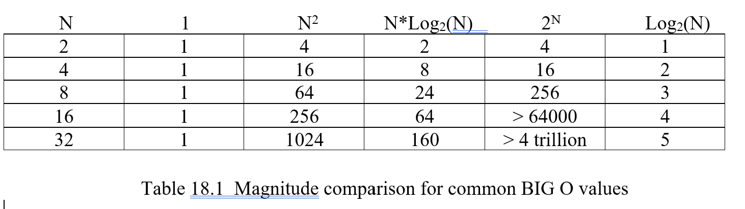
18.3 Comparing Orders of Magnitude

Slide 13
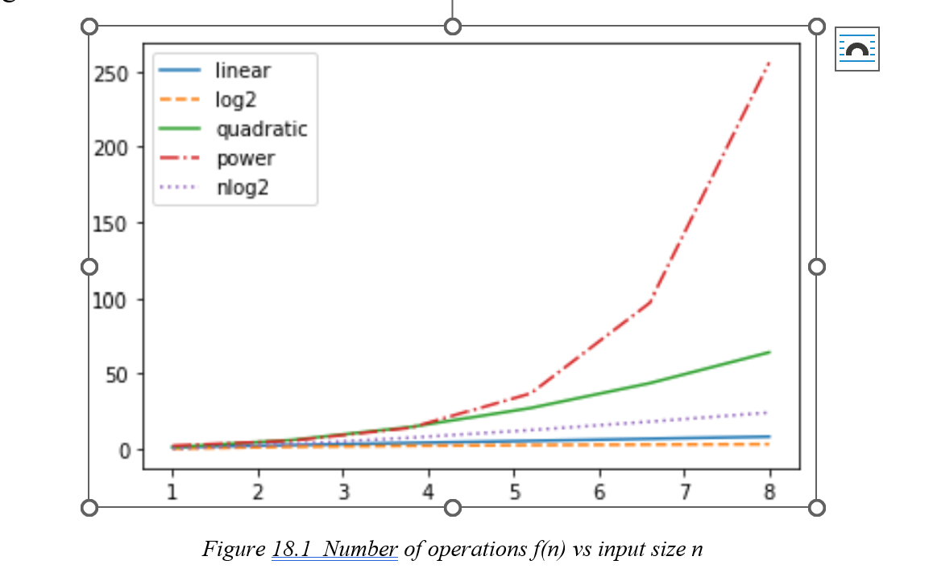
18.3 Comparing Orders of Magnitude

Slide 14


Slide 15


Slide 16
18.4 Comparison of Search Algorithms
Sequential Search Big O
for (int i = 0; i < n; i++) // n+1 times
{ if (arr[i] == target) // n times
return i;
}
return –1; // 1 time
worst-case: the target is not found, T(n)=2n+2, simplifies to O(n)
best-case: the target is found at arr[0], the total number of executed statements is 2, constant time, O(1)
average-case: the target is found after approximately n/2 iterations, O(n)

Slide 17
18.4 Comparison of Search Algorithms
Binary Search Big O
boolean found = false; // 1 time
int first = 0, last = n-1; // 1 time
while (first < last && !found) // k+1 times
{ mid = (first + last) / 2;
if (target < arr[mid])
last = mid –1;
else if (target > ary[mid])
first = mid + 1;
else
found = true;}
Notes:
Assuming the total number of halvings is k, the total number of iterations will be k+1. This leads to the following relationship:
n/2^{k} < 2 ==>
n < 2^{k+1} ==>
log₂n < k+1
So we can take the integer part of log₂n for k.
T(n) <= C*log₂n + 2, which is O(log₂n).

Slide 18
18.5 Comparison of Sorting Algorithms
Big O of Selection Sorting
for (int i = 0; i < n-1; i++){ // n times
best = i;
for (int j = i+1; j < n; j++) // n + (n-1) + (n-2) + . . . + 2: n(n−1)/2
if (arr[best].compareTo(arr[j]) > 0)
best = j;
if (i != best){
T temp = arr[i];
arr[i] = arr[best];
arr[best] = temp; } }
skip the exact computation and observe that it is a polynomial of degree 2 in n, leading to a time complexity of O(n2)
Notes:
the number of execution steps remains consistent regardless of whether it is the worst case, average case, or best case

Slide 19
18.5 Comparison of Sorting Algorithms
Big O of Bubble Sorting
boolean Sorted = false;
while (!Sorted){ // n times
Sorted = true;
for (int i = 0; i < n - 1; i++)
// n + (n-1) + . . . + 1
if (arr[i].compareTo(arr[i+1]) > 0){
T temp = arr[i];
arr[i] = arr[i+1];
arr[i+1] = temp;
Sorted = false;
}
}
Notes:
In bubble sort, the inner loop checks for any out-of-order pairs that need to be swapped. If no such pairs exist, the sorting process stops. In the best-case scenario, where the list is already sorted, no swaps are needed, making it efficient for this situation.
In the worst case, where the list is in reverse order, T(n)=O(n2).
In the average case, bubble sort’s time complexity remains O(n2) due to the same polynomial growth.
From our analysis, we can conclude that bubble sort performs better than selection sort when the list is already sorted or partially sorted, as the inner loop allows for early termination in such cases.

Slide 20
18.5 Comparison of Sorting Algorithms
Big O of Quicksort
if (first < last) // recursively executed
//each time the list splits in two = about log2n times
{
int pivotIndex = Split(first, last);
// inside Split: stmts. executed <= n times
Quicksort(first, pivotIndex - 1);
Quicksort(pivotIndex + 1, last);
}
Notes:
In the best case, the two sublists have approximately equal sizes, T(n) = n*log2n which is O(nlog2n).
the worst case occurs when the sublist is highly unbalanced around the pivot point, such as when the pivot is the smallest or largest element in the sublist. In this scenario, after each split, only one sublist remains, and the process continues until the sublist size becomes one. Therefore, the size of the sublist is reduced by one after each split, resulting in n splits. Since each Split() operation takes O(n), the total number of statements executed in the worst case is approximately T(n)=n2, which is O(n2).
In the average case, the time complexity is approximately T(n) = n*log2n which is O(nlog2n).

Slide 21
18.5 Comparison of Sorting Algorithms
Big O of Merge Sorting
if (low < high){
int middle = (low + high) / 2;
MergeSort(type, low, middle);
MergeSort(type, middle+1, high);
Merge(type, low, middle, high);
}
Notes:
The Merge() method compares elements from both sublists and stores the sorted elements in a temporary array, which requires about n iterations. Afterward, the elements from the temporary array are copied back into the original array, which also requires approximately n iterations. Therefore, the time complexity for merge sort is T(n) = n*log2n which is O(nlog₂n).

Slide 22
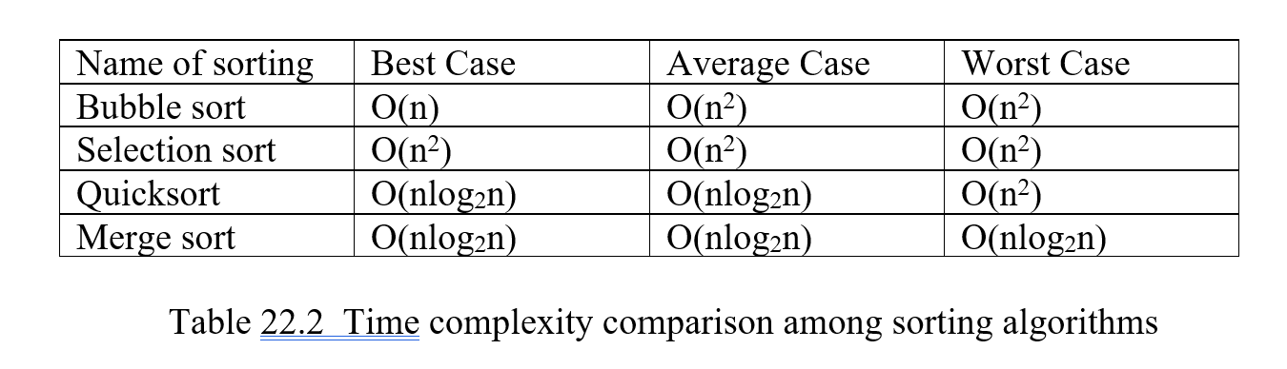
18.5 Comparison of Sorting Algorithms

Slide 23
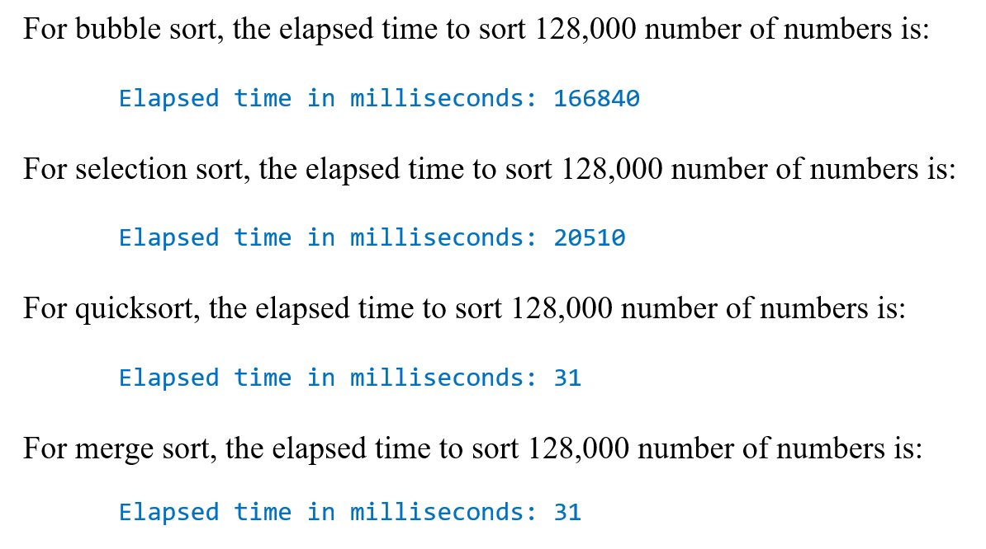
18.5 Comparison of Sorting Algorithms
JavaBigOhEx Example Running Result

Slide 24
18.6 Time Complexity for Recurrence Relation
public static double Power(double x, int n){
if(n == 0) // execute 1 time
return 1.0; // execute 1 time
return Power(x, n-1) * x; // execute T(n-1) times
}
T(n) = 2 + T(n-1)
= 2 + (2 + T(n-2))
. . .
= 2 + . . . + 2 + T(1)
= 2 + . . . + 2 + 2
= 2(n)

Slide 25
18.6 Time Complexity for Recurrence Relation
public static int Fib(int n){
if(n <= 2) // execute 1 time
return 1; // execute 1 time
return Fib(n-1) + Fib(n-2); // execute T(n-1)+T(n-2) times
}
T(n) = 2 + T(n-1) + T(n-2)
By analyzing the growth:
T(n) > 2*T(n-2)
T(n) > 2²*T(n-4)
. . .
T(n) > 2^{n/2 =>} O(2^{n}).

Slide 26
Which National Part is it?
Mammoth Cave National Park

